Slide 1

Marketing and Retail Analytics: Capstone Project
Ravishu Dhiman

Slide 2

AGENDA
Objective
Visualizations
Insights
Recommendations
Summary

Slide 3
OBJECTIVE
OList is one such e-commerce company that has faced some losses recently and they want to manage their inventory very well so as to reduce any unnecessary costs that they might be bearing.
Need to identify top products contributing to their revenue and use Market Basket Analysis to identify individual product categories and combinations that can help with sales improvement.

Slide 4
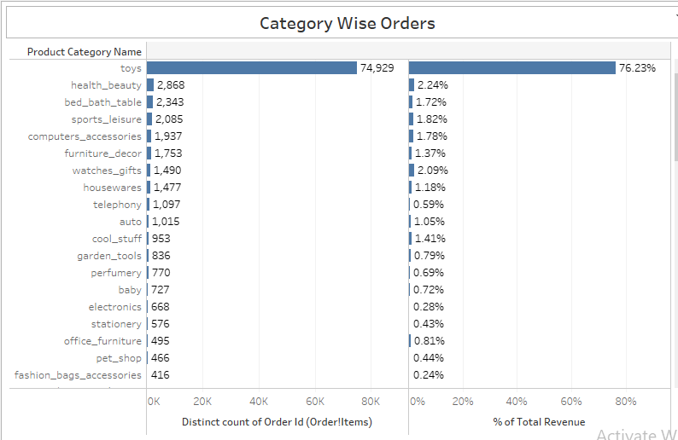
KEY
VISUALIZATIONS

Slide 5
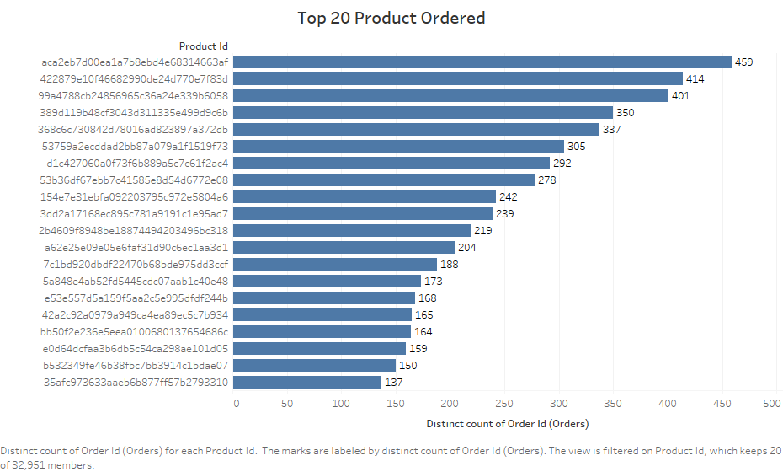

Slide 6
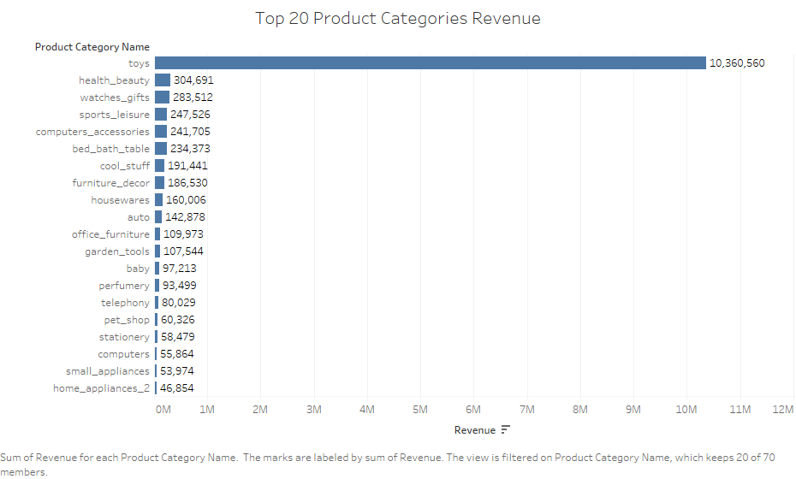

Slide 8
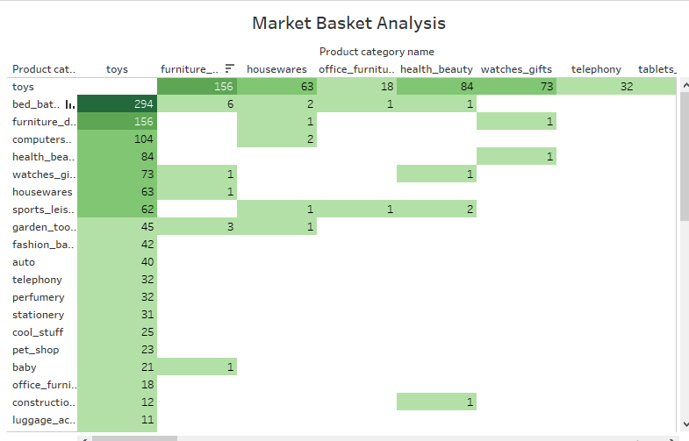

Slide 9
INSIGHTS
‘Toys’ is highest selling product category and price.
‘Toys’ alone contribute to about 76% of Total Revenue.
‘furniture’ go along pretty well with ‘toys’.
‘housewares’ and ‘office_furniture’ are two other product categories that have a fair link to ‘toys’.

Slide 10
Company should focus on giving offers for customers who are frequently purchasing to retain them.
‘Toys’ should be held in stock by a good margin as they are contributing to a significant amount of revenue.
Target customers who are more likely to buy toys: parents of newly born.
Many product categories and products are not much of a major contributor neither in terms of revenue nor in terms of number of orders, so Olist can consider removing these products or product categories or both to have an optimized inventory without affecting their sales much.
RECOMMENDATIONS

Slide 11
SUMMARY
The dataset available to us is called “Retail_dataset”. It is a xlsx file or simply a spreadsheet.
There are five worksheets in the excel file: orders, order_items, customers, payments and products.
The data available to us contains many duplicates and null values.
We filter down the values in the jupyter notebook and create a separate cleaned file.
After the completed treatment the cleaned data was exported to Retail_dataset_cleaned excel file as the same sheet names.
For the visualisation purpose, we use Tableau for gathering insights about different products and product categories as well as for Market Basket Analysis.
For Market Basket Analysis we need to create a separate dataset with the help of original dataset in excel itself.
Finally, market basket analysis for various combinations of product categories was conceived.

Slide 12

THANK YOU

